Slide 1
Coursera Capstone 2021
05/09/21

Slide 2
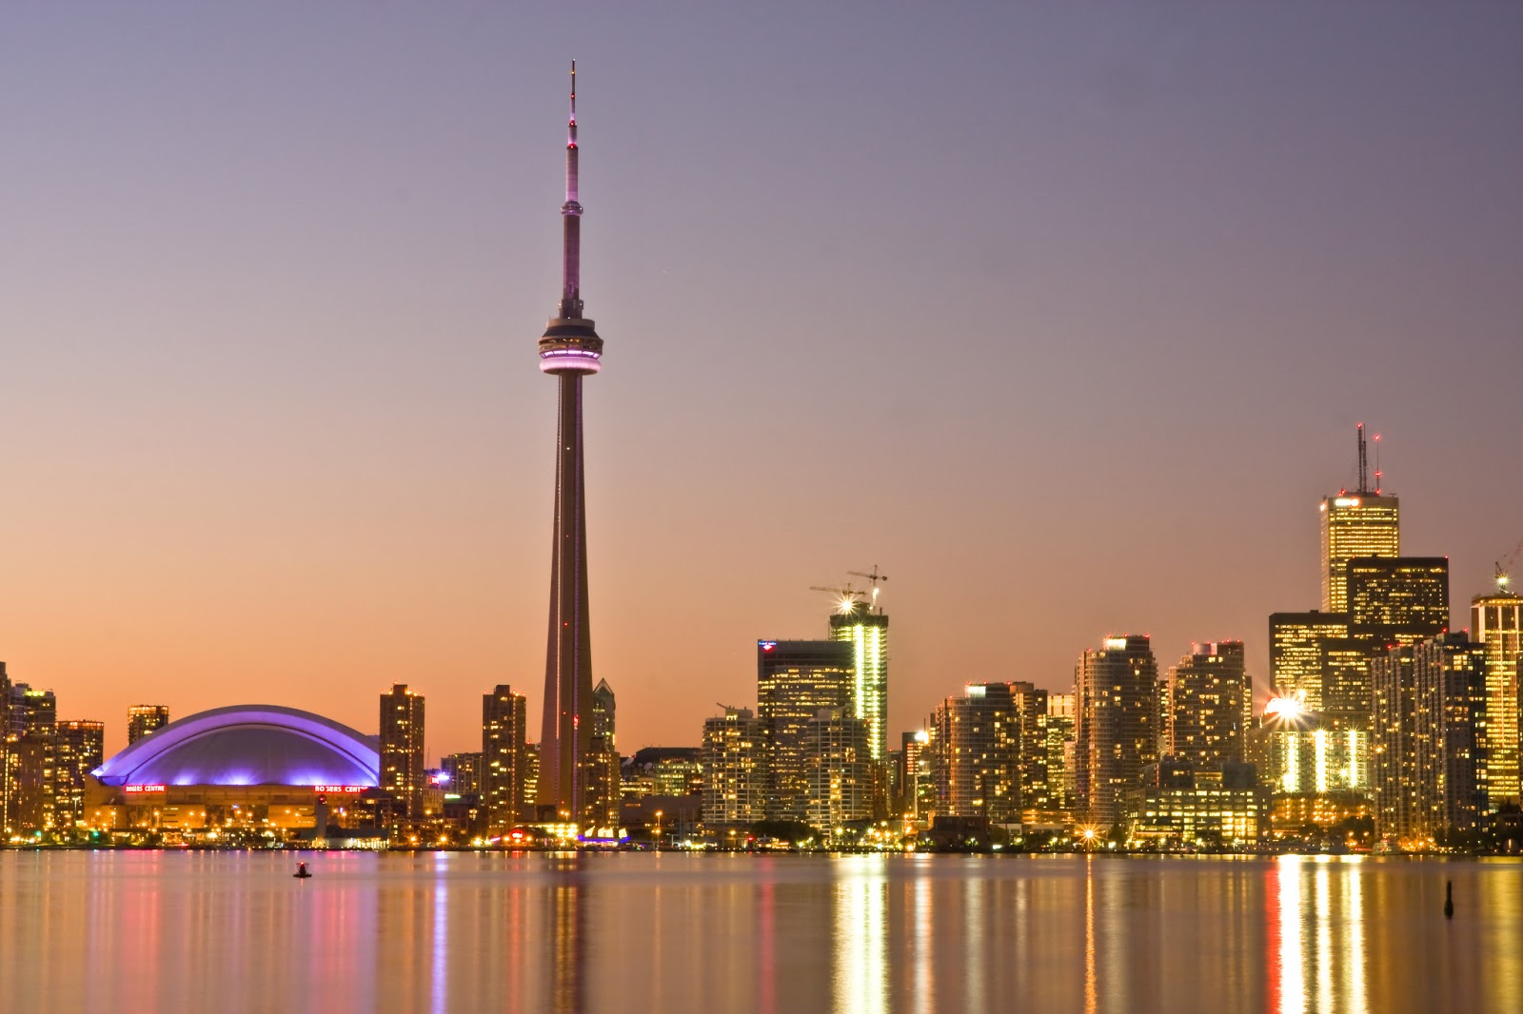
City of Opportunity: Toronto
Coursera Capstone 2021
City of Opportunity: Toronto
May 9th , 2021

Slide 3
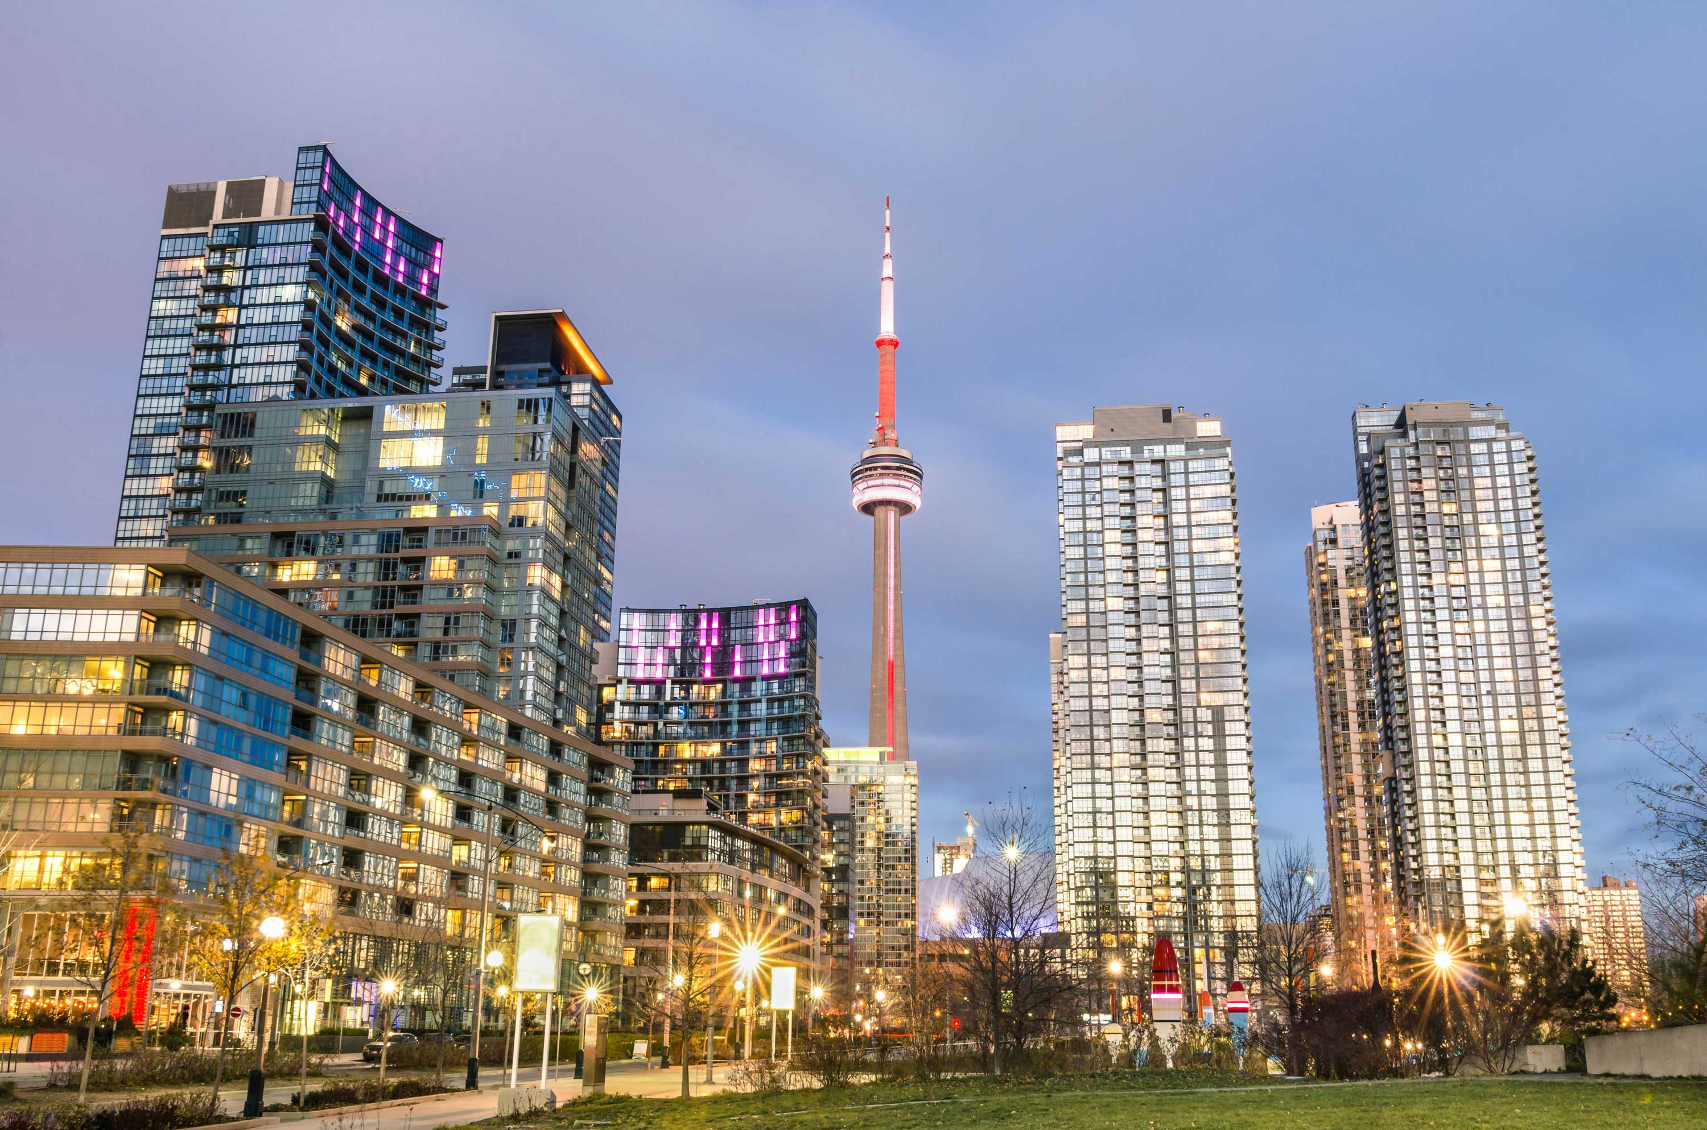
City of Opportunity: Toronto
Toronto is the capital city of the Canadian province of Ontario. It is the most populous city in Canada and the fourth most populous city in North America. Toronto is a culturally diverse and financially vibrate city and attracts many immigrants from all around the world.

Slide 4

Business problems
Wendy, a Chinese artist and investor wants to open an art gallery in Toronto. However, she is not familiar with the local area developments and dynamics. Therefore, she hires a data scientist to conduct research and identify the ideal location for her art gallery. The two main questions are: 1) What are the different neighborhoods of Toronto? 2) Which neighborhood is the best location for the art gallery?

Slide 5
Data sources
List of the districts of Toronto
Source: https://en.wikipedia.org/wiki/List_of_postal_codes_of_Canada:_M
Description: We will get a list of postal codes in Toronto Canada.
Geo-coordinate of the districts in Toronto
Source: http://cocl.us/Geospatial_data
Description: From the file of toronto_coordinates.csv on this website, we will get the latitude and longitude information of Toronto.
Top venues of districts in Toronto
Source: Foursquare API
Description: By using this API we will get all the venues in each district. We can group the areas into meaningful clusters.

Slide 6

Target audience
The target audience of this project are business owners or entrepreneurs such as Wendy who are not familiar with Toronto around areas but want to start a new business in this big city.

Slide 7
method
First of all, we downloaded the local districts and neighborhoods dataset from the Wikipedia web page, then cleaned and extracted the data into a Pandas DataFrame. Second, we created a table contains the list of districts in Toronto with the respective geo coordinates. Third, we collected venues for each district and see which venues are the most common. In this step, we used Foursquare API to collect venue data, organized into a Pandas DataFrame, and created a table of top venues in each district. Fourth, we used the K-means approach to group the Toronto neighborhoods into meaningful clusters. Finally, we visualized data with Folio.

Slide 8
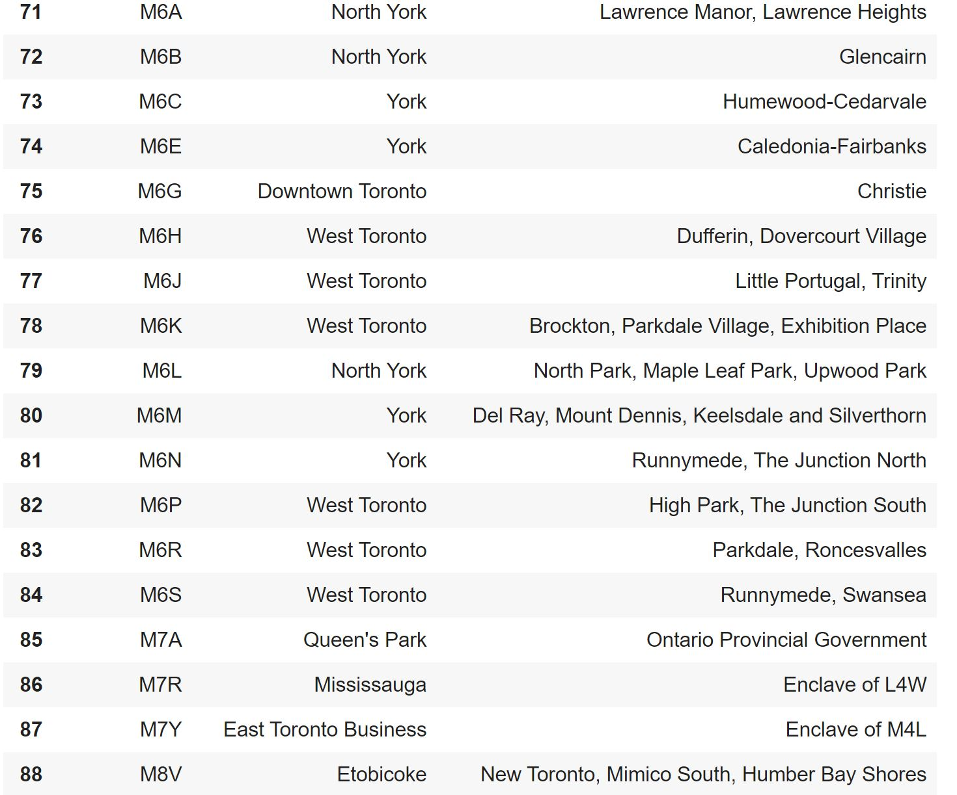
List of districts in Toronto

Slide 9
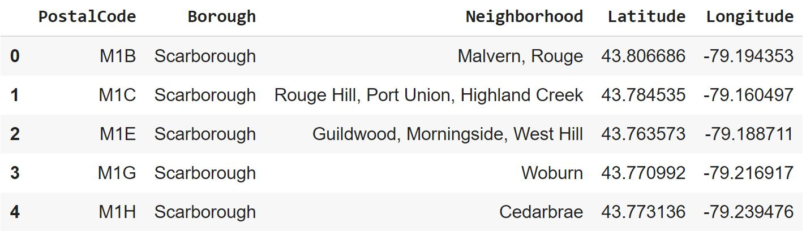
List of districts in Toronto with geo coordinates

Slide 10
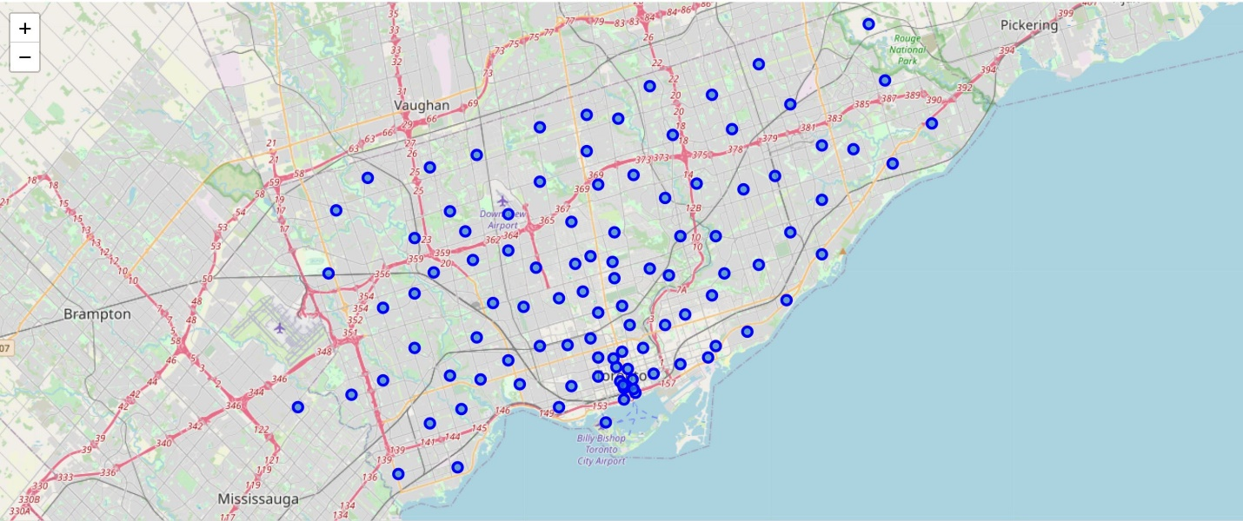
Map of Toronto neighborhoods

Slide 11
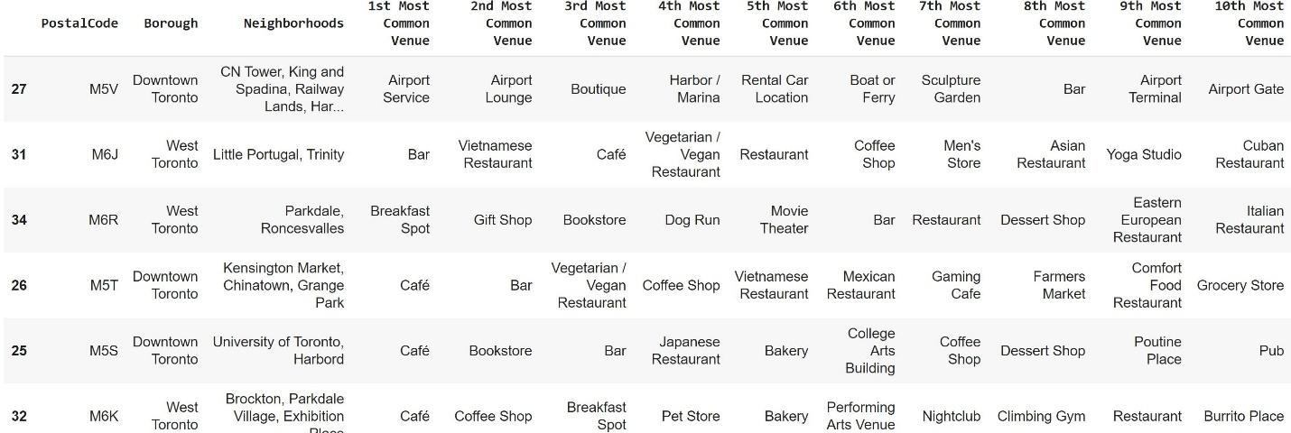
Ten most occurrence venue types in each district

Slide 12
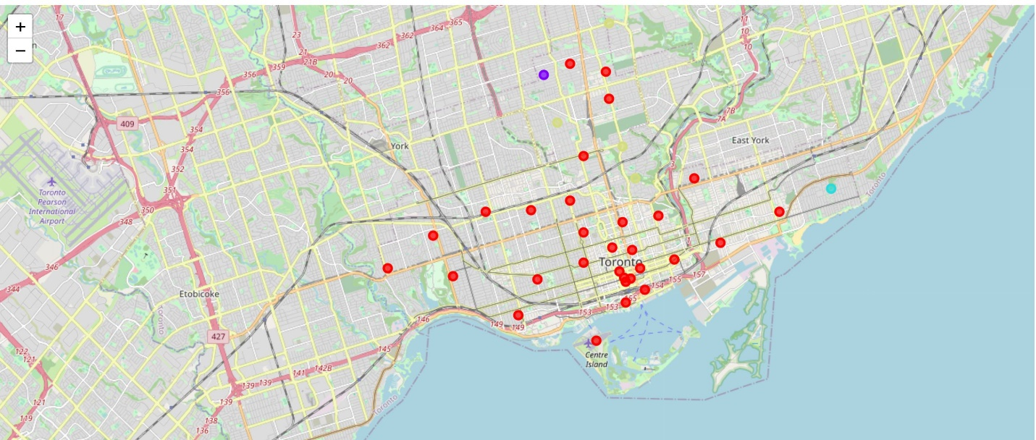
Map of clusters

Slide 13
Results
Upon observing the result, we can name the clusters as follow:
Cluster 1 (Red): Living area. This area is with mostly park, trail, school, and some small businesses.
Cluster 2 (Yellow): Roselawn. This area is in Central Toronto with nothing here except a garden.
Cluster 3 (Purple): Business area. This is the busiest and centralized area with lots of business venues.
Cluster 4 (Blue): Oldest neighborhood. This is the area with lot of nature parks.

Slide 14
Recommendation
Based on the result, the data scientist recommended the cluster 3 as the ideal location for Wendy to open her art gallery to attract more customers and generate maximum profit.

Slide 15
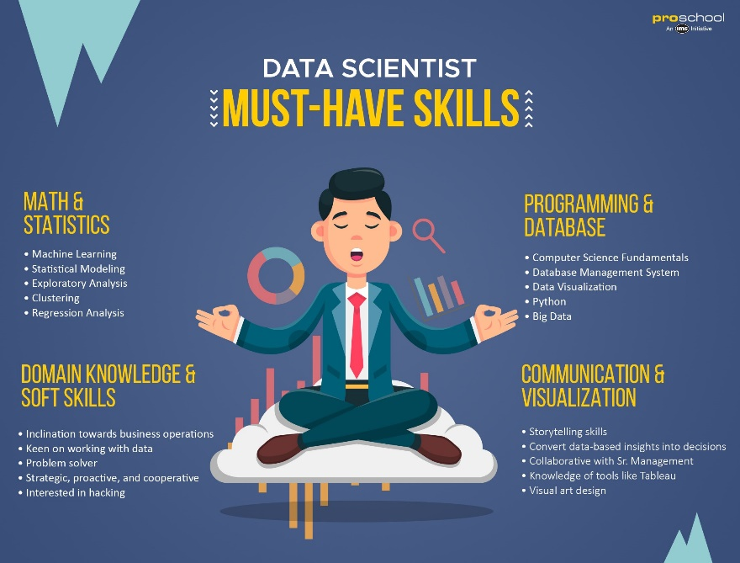
Conclusion
In this project, I worked as a data scientist to go through the process of identifying the business problems, specifying the data required, extracting and preparing the data, visualizing the results, performing machine learning by clustering the data into 4 clusters, generating insights, and making the recommendation to the client.

